Slide 1
Fire Fighting Robot USING ARDUINO
Group No-04
Submitted By: 1906005
1906008
1906009
1906012
1906019
1906030

Slide 2
Outline:
Implementation plan
Tools and Software Required
Progress so far
Challenges

Slide 3
Flow Chart
Distribute heat sensors in target zone of operation
Upon sensing temperature rise, sensor sends signal to microcontroller
Microcontroller of the robot identifies the location of accident using prebuilt map
Based on destination, microcontroller finds the optimum path to reach the location quickly
Using object detection, the robot will drive to destination safely avoiding further casualties
The robot pin points the fire using sensor attached to it
Using actuator motor, the robot will shoot water

Slide 4
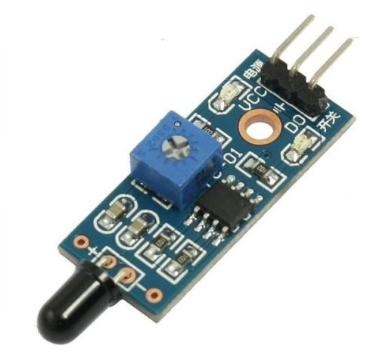
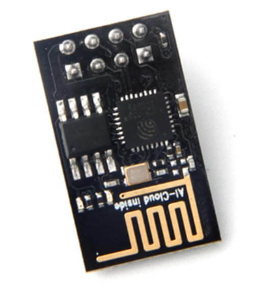
Heat Sensing
Flame Sensor fire detection module
ESP-8266(Wifi Module)
Flame sensor will send signal to Arduino uno using wifi module

Slide 5
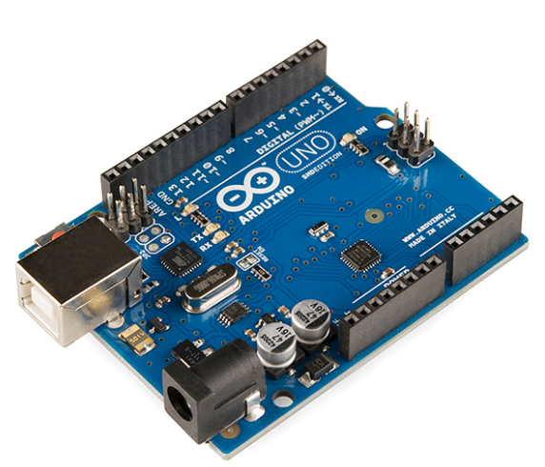
Control Mechanism
Arduino Uno
Controls the motors, pump etc.
Performs simple computational tasks
External Computational Unit
Run machine learning algorithms for object detection,
Localization (pyTorch)
Stores map information

Slide 6
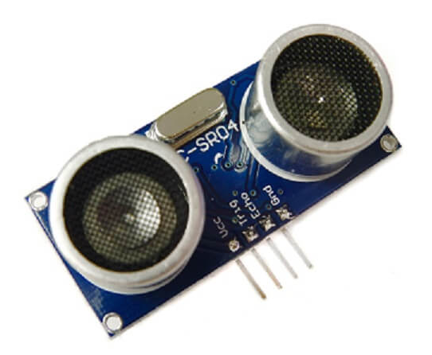
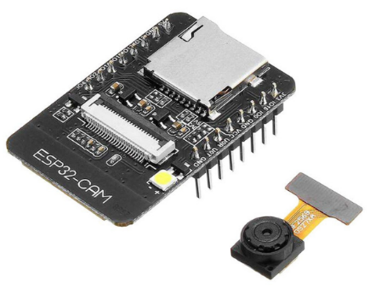
Localisation
HC-SR04 (Ultrasonic Sensor)
ESP32-CAM(Camera Module)
Distance estimation of nearby objects
Avoid collisions
Object Detection using computer vision
Determining self position in the map

Slide 7
Path Planning
1. Map Representation
Occupancy Grid Maps
Use K-D Tree for memory efficiency
2. Path Searching Algorithm
Dijkstra’s Algorithm
A* search

Slide 8
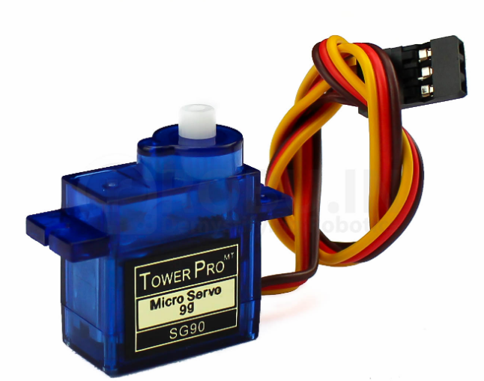
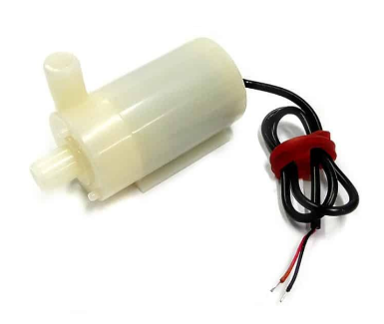
Target Lock and Flame extinguish
ESP32-CAM(Camera Module)
Flame Sensor
Combinedly Locate position of Fire
SG-90(Servo Motor)
Sets the required shooting angle
5V DC Mini-Water Pump

Slide 9
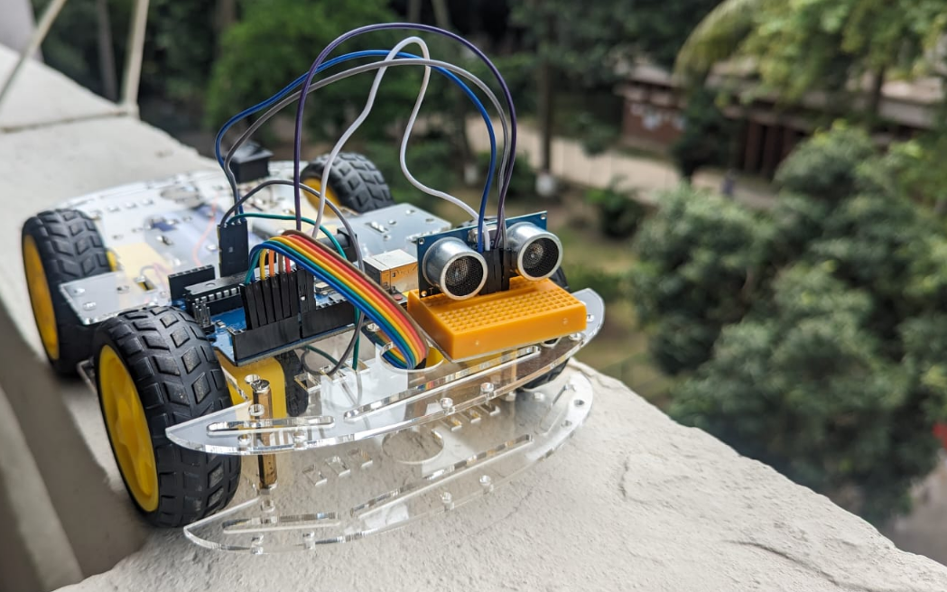
Progress So Far

Slide 10
Challenges
Localisation Without Lidar
Inability to perform on board heavy computation

Slide 11
Thank You!
Any Questions?

